Slide 1
Module : OP&E Tools
Merchandising Management
Notes:
Good Morning/ Afternoon
Today my main objective is to keep you” awake and interested” in understanding the overall tool support for Merchandising Management.
Feel free to ask any questions you may have; we will answer immediately or at the end of the chapter.
A little logistic reminder > please switch off your portables. Thanks

Slide 2
Objectives of this module
After this module, you will be able to
  Understand how the TME applications support the BP processes for Merchandising Management
  Create Clusters in Siebel Marketing and use them in Siebel Sales CG
  Create Merchandising Programs and cascade them to multiple accounts
  Review Merchandising data in Siebel Analytics
Notes:
Review key objectives as documented on the slide with your participants.

Slide 3
Table of contents
Introduction to Better Practices for Merchandising Management
  Definition
  Process Overview
  Capability Interdependencies
Tool support for Merchandising Management processes
  JTI versus Siebel Terms
  Tool support
  Tool step overview by BP process
  Tool steps in detail
  Tool demo
  Exercises

Slide 4
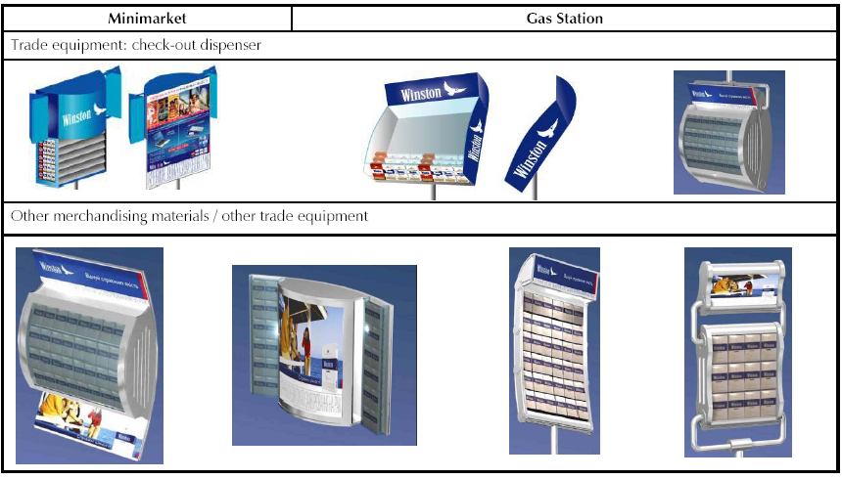
Introduction
Merchandising Management - Definition
Merchandising Management:
  Once Brand and Channel priorities have been set, Outlets have been segmented and the level of merchandising investment has been determined, Merchandising Management is the process of ensuring availability of JTI product at the point of purchase by, and supportive of, Assortment Management and Space Management as well as Promotions Management. Merchandising programmes are driven by assortment, space and promotions plans.

Slide 5
Introduction
Merchandising Management – Process Overview
Process Overview
Process Description
Review merchandising requirements
Review the merchandising objectives from brand marketing & Channel / Segment / Account management. Review the requirements from brand marketing, Channel / Segment / Account, Space and Promotion management.
H1
H1
Develop a generic merchandising program
Develop a generic merchandising program per channel / segment / cluster, defining merchandising programs details and objectives and metrics.
H2
H2
Customize merchandising
program by
account / outlet
Customize the generic merchandising program by account / outlet – taking consumer characteristics and account / outlet characteristics into account as well as customization requests.
H3
H3
Develop merchandising materials
Collaborate with selected consumer -oriented agencies to design and with procurement to procure the merchandising materials.
H4
H4
Ensure execution / deployment of merchandising materials
Ensure execution and deployment of merchandising materials. Communicate merchandising instructions & guidelines to the Operational Planner, ensure proper installation and evaluate consumption.
H5
H5
Evaluate merchandising efficiency & effectiveness
Measure the merchandising compliance against merchandising implementation plan. Measure merchandising effectiveness and efficiency. Issue evaluation report.
H6
H6

Slide 6

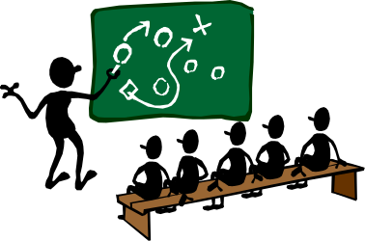
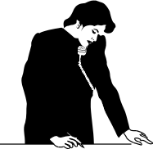


Introduction
Merchandising Management – Interdependencies
Trade
Marketers
Brand
Channel & Segment
Account Mgmt
Visit Reporting
Space & Promotion Mgmt
1
Review requirements
Evaluate efficiency
& effectiveness
6
Category Developer
2
Develop Generic
Merchandising Program
Merchandising Management
5
3
Customize Program by Account/outlet
Ensure execution Merchandising Programs
4
Detail & Assign
Merch. activities
Develop
Merchandising Materials
Operational
Planner
Procurement
Agencies

Slide 7
Table of contents
Introduction to Better Practices for Merchandising Management
  Definition
  Process Overview
  Capability Interdependencies
Tool support for Merchandising Management processes
  JTI versus Siebel Terms
  Tool support
  Tool step overview by BP process
  Tool steps in detail
  Tool demo
  Exercises

Slide 8
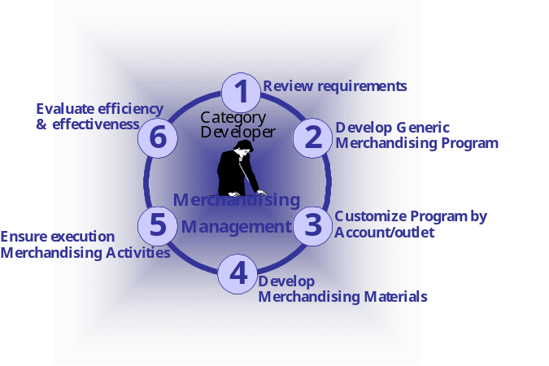
H.1 Review Merchandising requirements
Tool support
Input:
From who What
Tool
support
Objectives
Specific Reqs
Process
action
Brand Marketing
Channel / Segment /
Account Mgmt
Category
Developer reviews merchandising requirements
via File Upload
Siebel
Sales
Specific Reqs
“Literature” screen
“Attachments” view:
Specific requirements related to Merchandising Program
Space Mgmt /
Promotion Mgmt

Slide 9
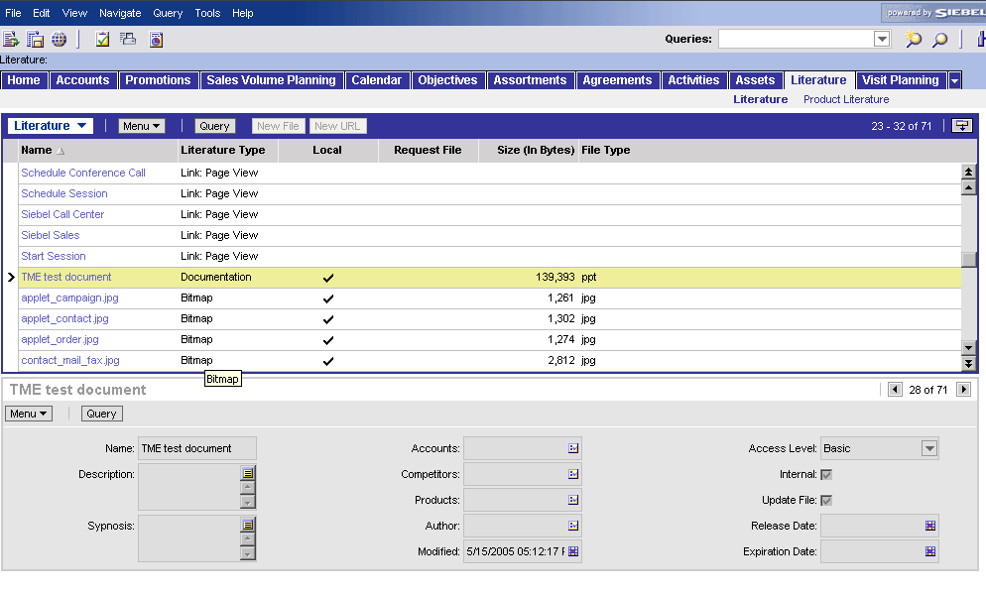
H.1 Review Merchandising requirements
The “Literature” screen (1/2)
View:
Tool actions:
  Literature screen shows all information which can be downloaded for different purposes: the ASP, Merchandizing catalog, Sales presentations, contracts, etc.
  Access to the files depends on your user rights
  Searching for a specific file can be done through scrolling up and down or either using the Query Function

Slide 10
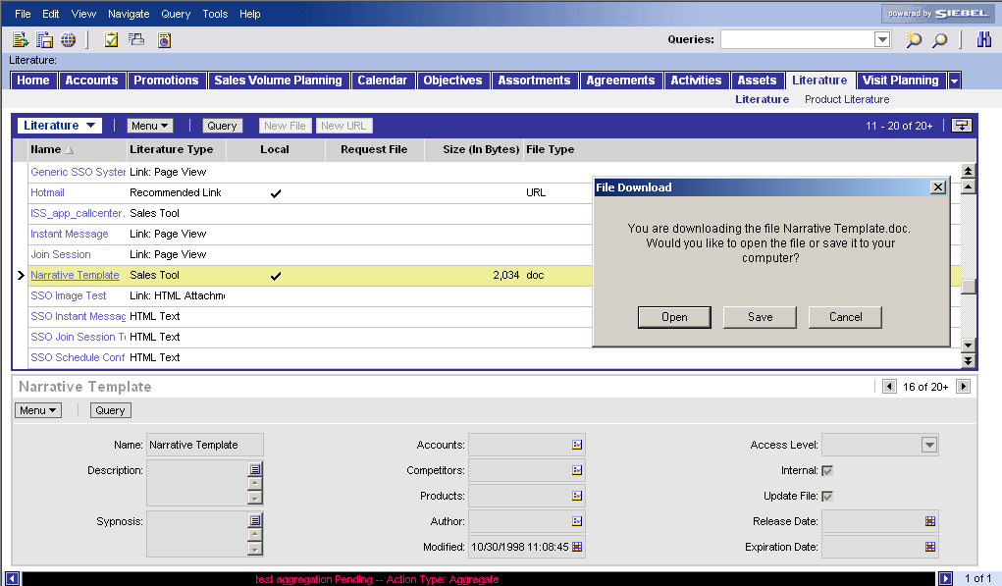
H.1 Review Merchandising requirements
The “Literature” screen (2/2)
How to access file in Literature screen
Access the “Literature” screen (click on Tab “Literature”)
Search document
  by scrolling down (drag scroll bar with mouse)
  by using the query function (click on query and fill in fields to narrow the selection of the list of files in the Literature view)
Open the file
  Click on file
  Choose “Open” or “Save” (to have local copy on hard drive)
1
2a
3a
3b
2b
You can not modify files in the Library, only local copies of the file on your hard drive

Slide 11

H.2 Develop a Generic Merchandising Program
Tool support
How do you develop a Generic Merchandising
Program?
Better practice process steps
  Select the Merchandising options
  Perform a Cost / Benefit Analysis
  Review / Validate allocated Budget
  Obtain Approval for Budget & Merchandising Program
  Define / Refine the details of the Merchandising Program
  Define the Metrics of the Merchandising Programs
  Communicate Merchandising Program
Siebel
Sales
Siebel
Sales
Siebel Sales support for BP process steps

Slide 12

H.2 Develop a Generic Merchandising Program
Tool steps
How do you develop a Generic Merchandising
Program? This can be a JTI or even a competitor’s
merchandising program.
Tool steps in Siebel Sales
Create a new budget
Create a new Generic Merchandising Program
Review and validate the calendar
Define and detail the program’s objectives
Define material quantities and calculate cost
Compare total cost versus budget
Refine the details of the Merchandising Program
Add attachments with useful information
Sales
Document the metrics and measurement methodology
Select target accounts
Communicate program to merchandising plans

Slide 13
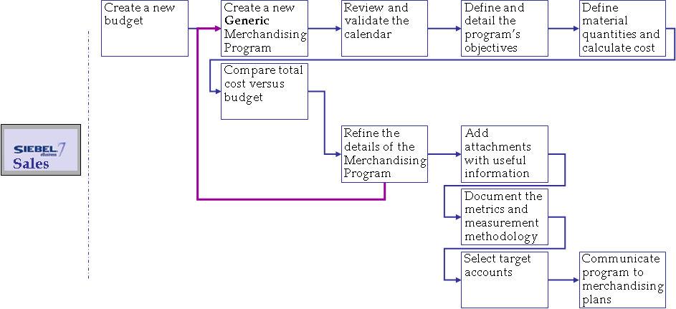
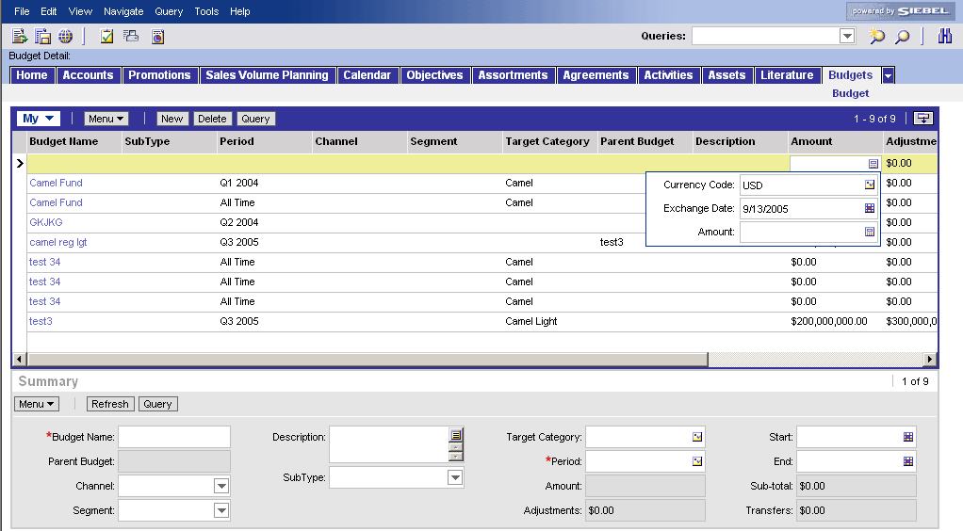
H.2 Develop a Generic Merchandising Program
H.2.1 Select the Merchandising options
How do you create a new budget?
Add new Budget
Go to screen “Budget”
Click “New” button in the list applet at the top
1
2
3d
Fill out first the mandatory fields
  Fill in name of new Budget in the column “Budget Name”
  Indicate the period during which the Budget is valid by picking a period in the pick applet used to populate the “Period” column
  The fields “start date” and “end date” are automatically updated
  Add the budget amount in the “Amount” column
3a
3c
3b

Slide 14
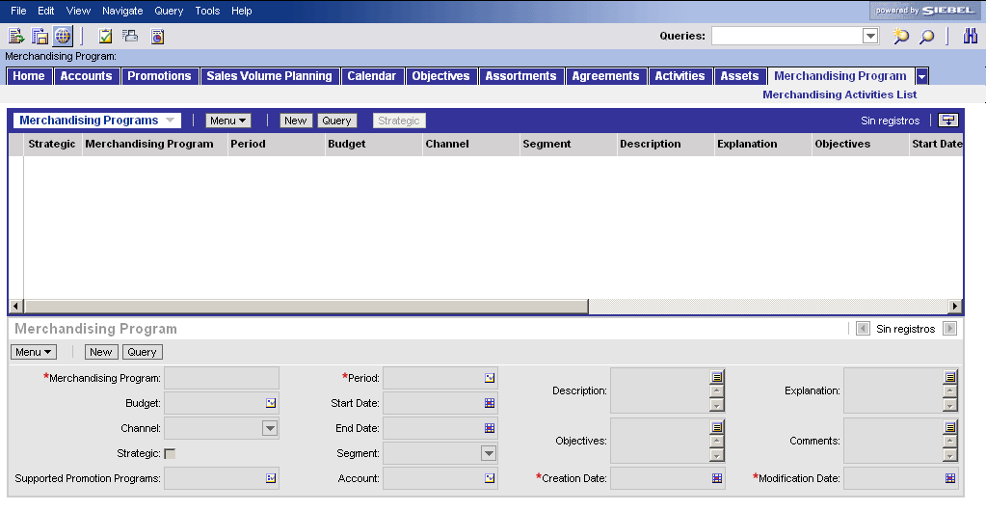
H.2 Develop a Generic Merchandising Program
H.2.1 Select the Merchandising options
How do you create a new generic
Merchandising Program?
Add new Merchandising Program
Go to screen “Merchandising Program”
Click “New” button in form applet below
Fill out first the mandatory fields
  Fill in name of new Merchandising Program in the field “Merchandising Program”
  Indicate the period of the Program by opening the pick applet within the Period field and choosing one period
  The fields “start date” and “end date” are automatically updated according your choice
1
2
3a
3b
3c

Slide 15
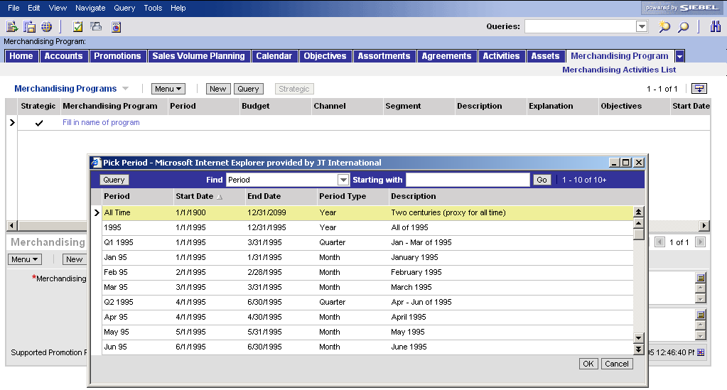
H.2 Develop a Generic Merchandising Program
H.2.1 Select the Merchandising options
Example of pick applet for “Period”:
This pick applet is similar to the one
for the fields “Budget” and “Account”
Select a Period
Search for the record by scrolling or using the field “Starting with:” (add letters and press Go)
Click on the preferred record: it will turn yellow
Press OK
1
2
You can only pick one single value
3

Slide 16
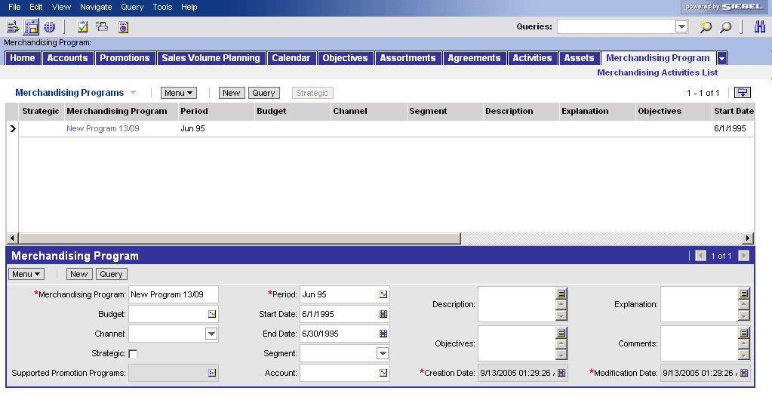
H.2 Develop a Generic Merchandising Program
H.2.1 Select the Merchandising options
How do you complete the main fields for
creating a new Merchandising Program?
Complete main fields for a Merchandising Program
Select from a pick applet the Budget (created earlier)
Optional step: Select the target “Channel and/or Segment” for execution of the program in case specific for channel/segment.
Add promotion programs that are supported by the Merchandising Program
Describe in more detail the program (use the upper text field button)
Add other instructions/comments
1
4
2
5
2
3

Slide 17
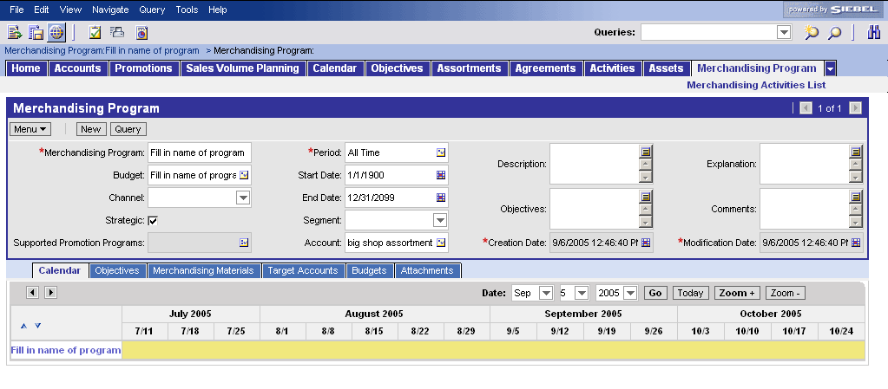
H.2 Develop a Generic Merchandising Program
H.2.1 Select the Merchandising options
How do you check whether the timing of the
Merchandising Program is in line with other
JTI or competitor programs?
Validate timing of Merchandising Program
Go to view “Calendar”
Navigate to the right time period
  Select a date and press go
  Zoom “in” or “out” to change range
Compare overlap between different Merchandising Programs
Change period if needed (pick applet)
4
1
2a
2b
3

Slide 18
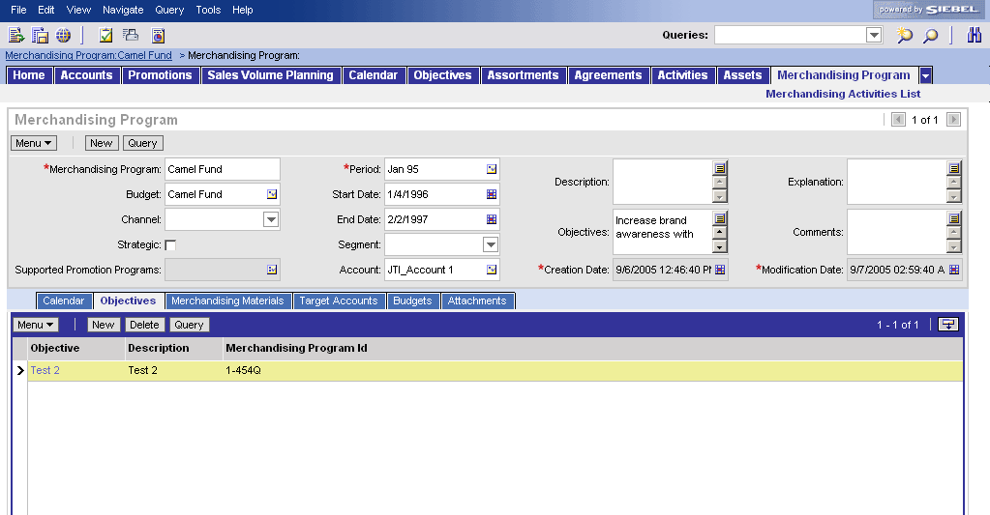
H.2 Develop a Generic Merchandising Program
H.2.1 Select the Merchandising options
How do you define the different objectives for
the Merchandising Program?
Define & document objectives
The category defines the high level objectives for the program
Go to the “Objectives” field in the form applet and describe objective(s)
The operational planner later defines the specific objectives (such as Trade Marketing activities) that support the program
The operational planner will use the “objectives” applet (described in Operational Planning)
1
2

Slide 19
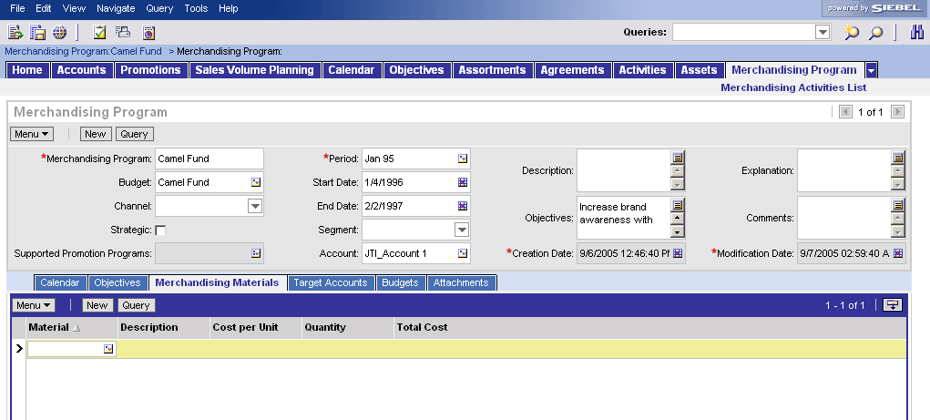
H.2 Develop a Generic Merchandising Program
H.2.1 Select the Merchandising options
How do you select the materials, their quantities
and calculate the cost of the program?
Material selection and cost analysis
Go to the “Merchandising Materials” view
Click on “Material” field in the list applet and select in the pick applet the material applicable to the merchandising program
Repeat this step to select various materials
The fields “Description” and will show the information
Indicate the quantity needed for all target accounts/outlets and the cost per unit per material
The total costs related for the need for the selected merchandising article will automatically be shown
(total for all accounts/outlets)
1
2
3
4

Slide 20
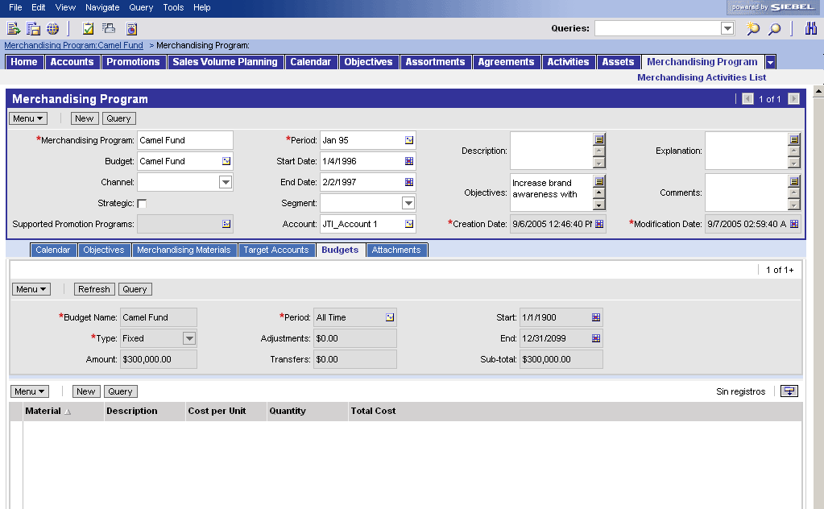
H.2 Develop a Generic Merchandising Program
H.2.2 Perform a Cost / Benefit Analysis
Is the total cost within budget boundaries?
Cost vs Budget analysis
Go to view “Budgets”
Budget data cannot be modified in this view (in “Budget” screen)
In the list applet below you see the program’s material with its quantities and its total cost.
Assess whether total cost is within the budget
Modify quantities or add/remove material entries(described previously)
1
2
3

Slide 21
H.2 Develop a Generic Merchandising Program
H.2.5 Refine the details of the Merchandising Program
How do you refine the details of the
Merchandising Program?
Refine program details
After the cost/benefit analysis you might want to refine the details and characteristics of your merchandising program
Repeat the previously documented tool steps and change fields in form applet and fields in the other views if required
1

Slide 22
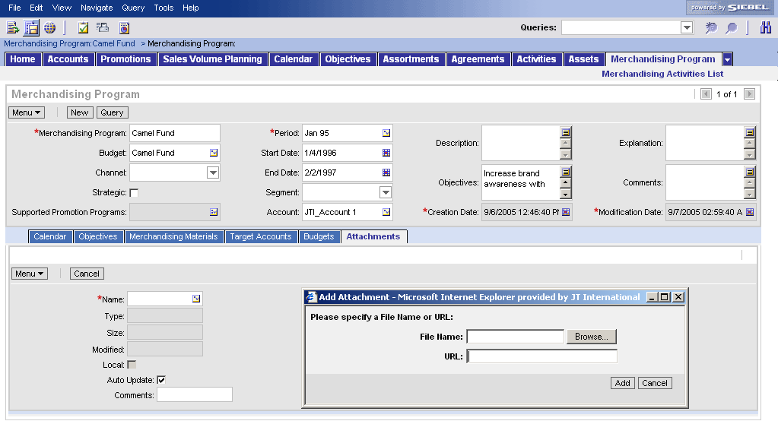
H.2 Develop a Generic Merchandising Program
H.2.5 Refine the details of the Merchandising Program
How do you attach documents to a
Merchandising Program?
Add an attachment
Go to “Attachments” view
Click on the “New” button, go to the field “Name” and click on the button on the right of the field
A window pops-up
Click on “Browse” button
Select the file from a local drive and press “OK”
In case you want to attach a link to a website, add the address in the “URL” field
Press “Add”
Add text in the comment field if you want to add more comments regarding the file
1
2
3
4
6
5

Slide 23
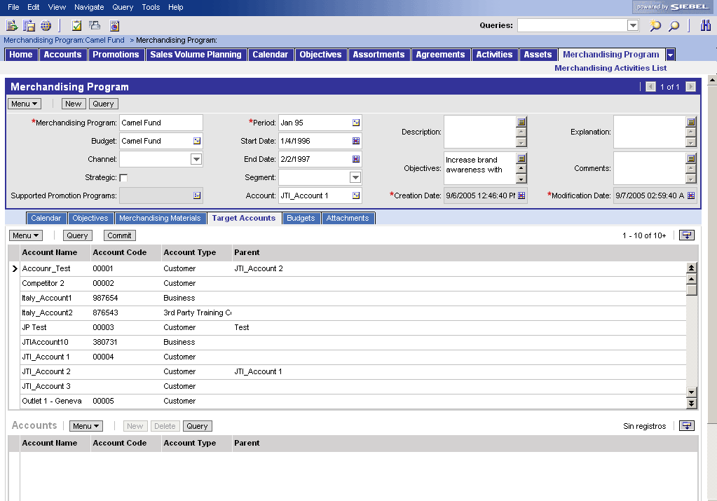
H.2 Develop a Generic Merchandising Program
H.2.6 Define metrics of the Merchandising Programs
How do you document the measurement
methods?
Documenting metrics to track objectives
Go to the field “Explanation” in the main form applet
Add text on how to track objectives and which metrics you will use
(use the text edit button to add text in larger window)
1

Slide 24
H.2 Develop a Generic Merchandising Program
H.2.7 Communicate the Merchandising Program
To select the Target Accounts there exist 2 options
  Select each target account in the “Target
  Accounts” view from the account list
  Define a cluster (Siebel Marketing) and allocate
  the cluster to the Merchandising Program
  Define a cluster (target list in Siebel Sales)
Select Target Accounts
Option 1: pick accounts from account list
Once all details of the Merchandising
Program are reviewed and approved
Go to “Target Accounts” view
Select the accounts (use Ctrl button + mouse clicks -> selected records turn yellow.
Press “Commit” button (see next tool step “communicate merchandising program”)
1
3
2

Slide 25
H.2 Develop a Generic Merchandising Program
H.2.7 Communicate the Merchandising Program
How do you define a cluster (optional step)?
Create a cluster of outlets (segment)
Select Target Accounts
Option 2: Create a cluster in Siebel Marketing and load it in Siebel Sales CG
Tool Steps
Marketing
Create a List and import Accounts
Sales
Go to the created Merchandising Program
Select accounts (Target List or manual) and apply

Slide 26
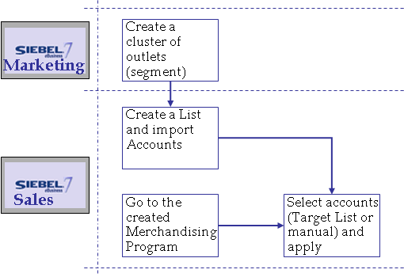
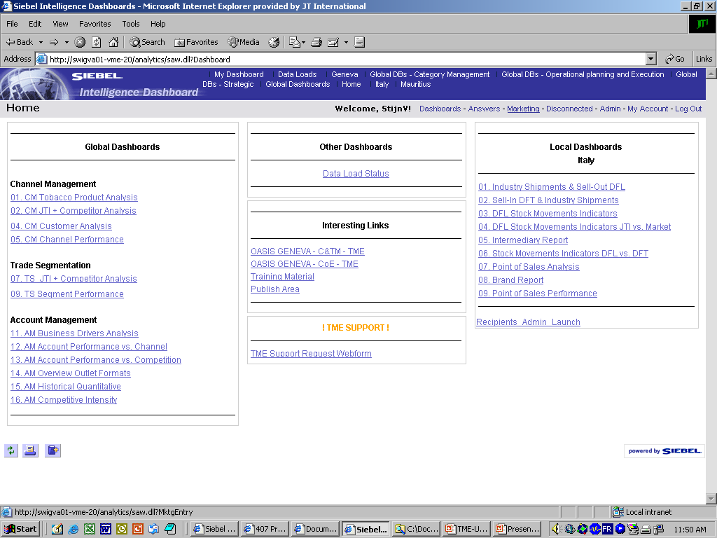
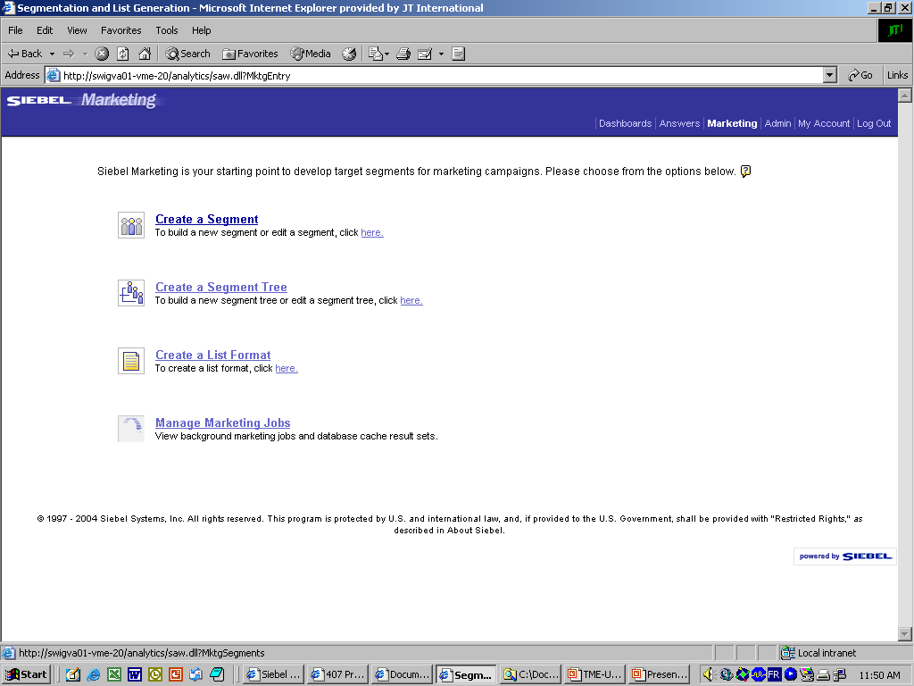
H.2 Develop a Generic Merchandising Program
H.2.7 Communicate the Merchandising Program
How do you define a cluster? (1/3)
(optional step in Siebel Marketing)
1a
1b
2
Select Target Accounts
Option 2: Create a cluster in Siebel Marketing and load it in Siebel Sales CG
Navigate to Siebel Marketing Analytics
  Login into Siebel Analytics (Insight)
  Click on ‘Marketing’ in the Menu bar
Click “Create a Segment”

Slide 27
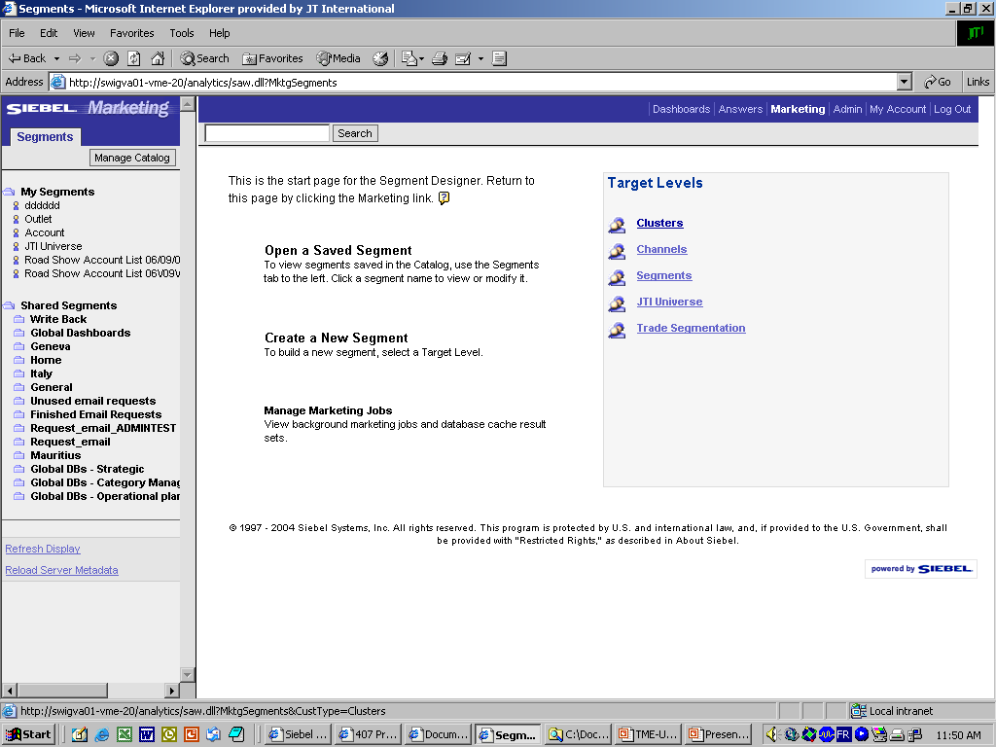
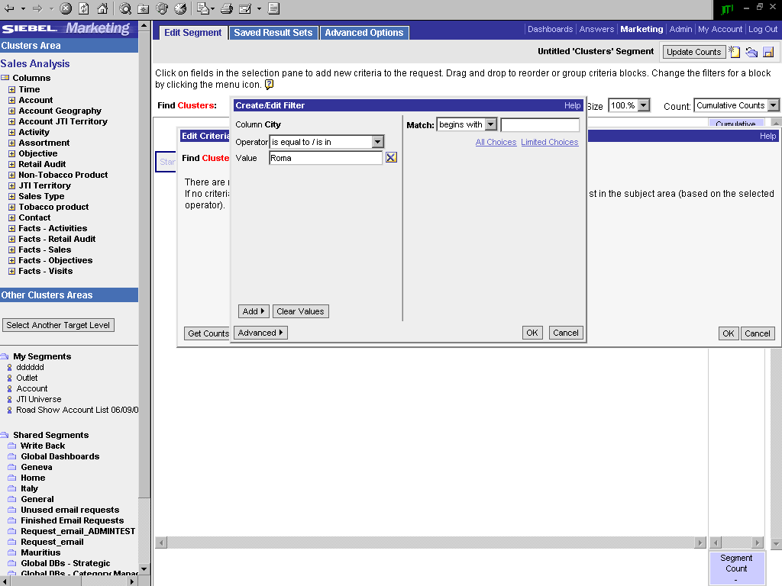
H.2 Develop a Generic Merchandising Program
H.2.7 Communicate the Merchandising Program
How do you define a cluster? (2/3)
(optional step in Siebel Marketing)
3
4a
4b
4c
Select Target Accounts - Option 2
Select the cluster level to be created
To create a new cluster, define the variables:
  Choose among variables
  For each variable, define search method: Operator
  And enter value
  Click OK
2d
Clusters created by the user
Shared clusters

Slide 28
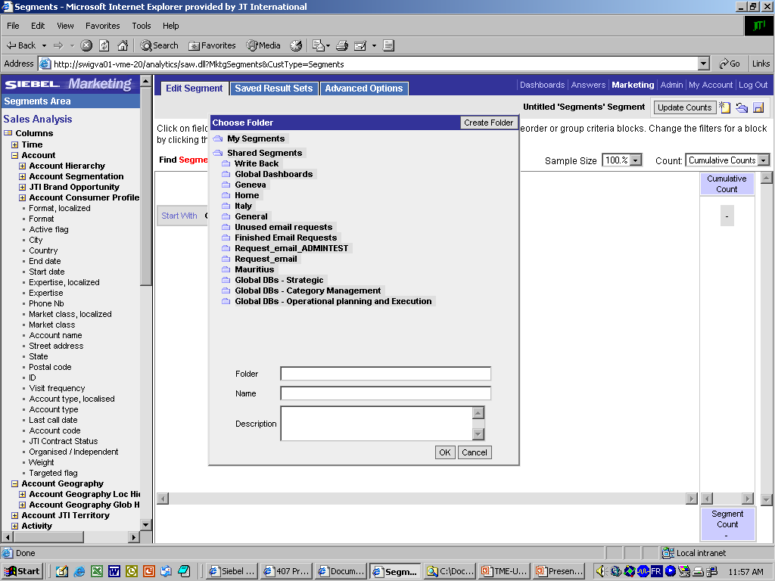
H.2 Develop a Generic Merchandising Program
H.2.7 Communicate the Merchandising Program
How do you define a cluster? (3/3)
(optional step in Siebel Marketing)
1
2
2a
Select Target Accounts - Option 2
Click the Save icon
Save:
  Select a folder where you want to save the Cluster
  BE AWARE! The value shown in the field “Folder” is equal to the value you will have to add later in the field “Analytics Path” when importing the cluster within a Target List in Siebel Sales
  Enter name for the cluster
  BE AWARE! The value shown in the field “Name” is equal to the value you will have to add later in the field “Segment Name” when importing the cluster within a Target List in Siebel Sales
2b

Slide 29
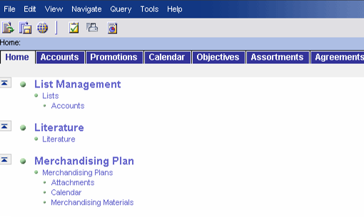
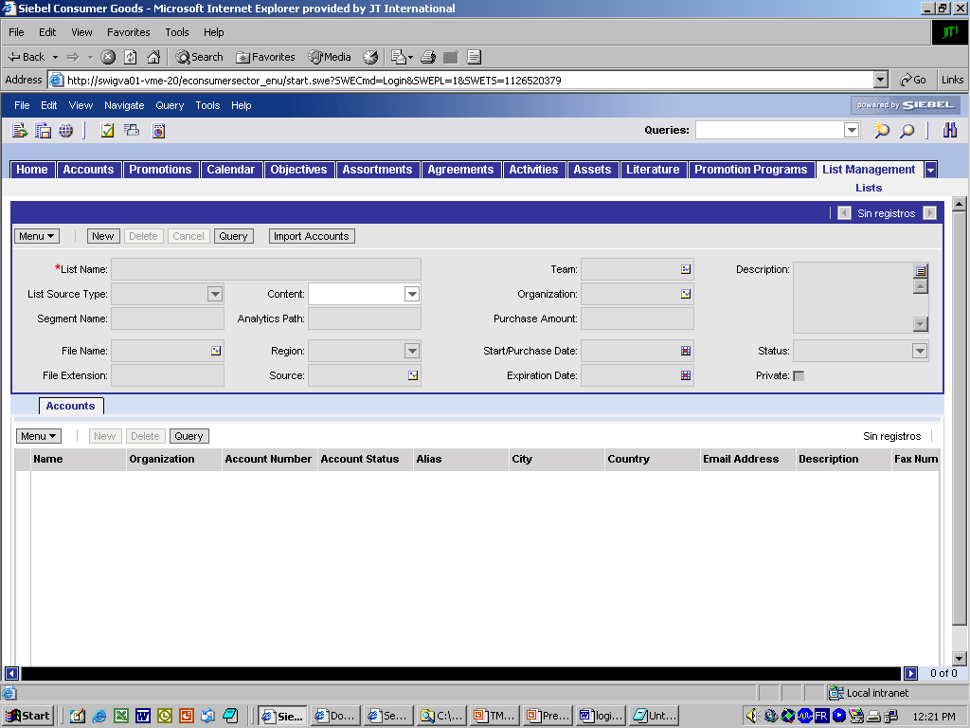
H.2 Develop a Generic Merchandising Program
H.2.7 Communicate the Merchandising Program
How do you load the cluster?
Tool steps in Siebel Sales
1
2a
2b
Select Target Accounts - Option 2
Log into Siebel Sales CG
Navigate to the List Management functionality
  Go to the site Map
  Go to the List Management/ Lists/Accounts view
Create a new list that will contain the cluster
  Click New
  Enter List Name
  Choose value ‘Targeted List’ in the List source type drop-down menu
  Enter the Analytics Path for Siebel to import the correct values (The “Folder”)
  Enter exact name of the Segment created in Analytics
Click ‘Import Accounts’
The accounts are listed in the bottom list-applet
3a
4
3b
3c
3e
3d
5

Slide 30
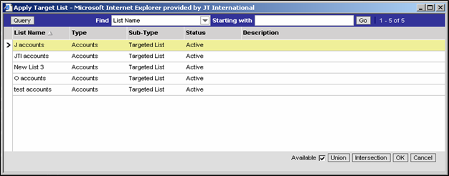
H.2 Develop a Generic Merchandising Program
H.2.7 Communicate the Merchandising Program
How do you add the Target Account list
to a Merchandising Program?
2a
Detail-applet of the record
Select Target Accounts - Option 2
Navigate to the Target Account view
Picking a Target List
  Click on the Target List icon.
  In the pick-applet window, select the List and click OK
The middle list-applet of accounts is replaced by only the accounts contained in the Target List
Select all accounts (Ctrl+A)
Click the ‘Commit’ button
The accounts are now added in the bottom list, and applied to the Merchandising Program
1
List-applet of accounts
2b
3+4
List-applet of accounts
applied to the Merchandising Program
6

Slide 31
H.2 Develop a Generic Merchandising Program
H.2.7 Communicate the Merchandising Program
How do you communicate the program and
create Merchandising Plans for the target outlets?
Generate the merchandising plan
Once all details of the Merchandising
Program are reviewed and approved and the target clusters/accounts selected
Go to “Target Accounts” view
Select the Target Accounts for your Merchandising Program (see previous 2 options for account selection)
Press “Commit” button
This button creates copies of the Merchandising Program on outlet level, called “Merchandising Plans”
Open the “Merchandising Plan” screen (see next page)
4
1
3
2

Slide 32
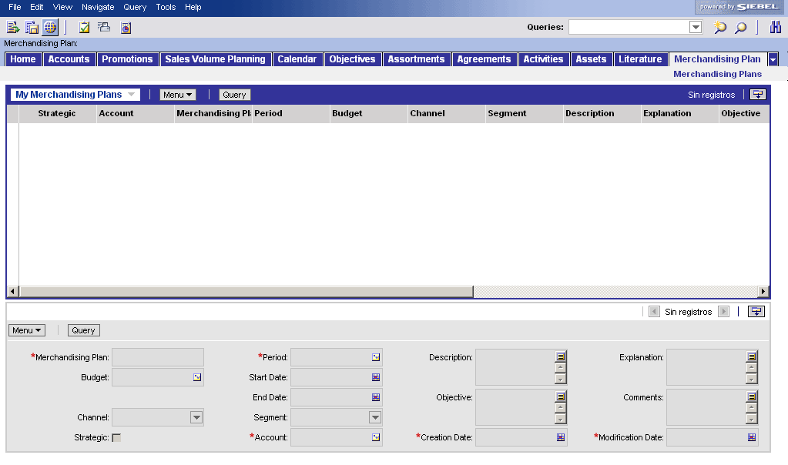
H.2 Develop a Generic Merchandising Program
H.2.7 Communicate the Merchandising Program
How do you validate a Merchandising Plan at
account/outlet level is created?
Review the Merchandising Plan at account/outlet level
Go to the “Merchandising Plan” screen
Review the fields copied automatically from the Merchandising Program, i.e.
  Calendar
  Materials
Modify the fields which can be adapted, i.e. objectives, attachments
1
2
3

Slide 33
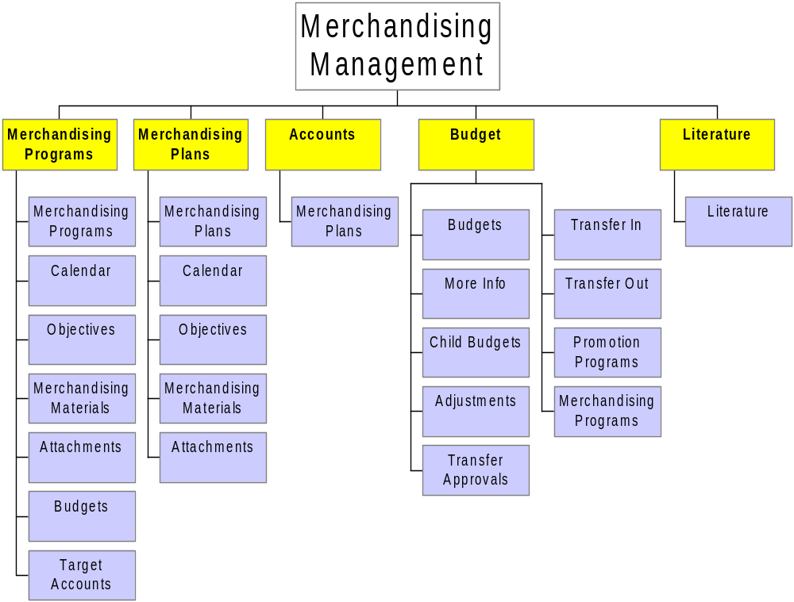
H.2 Develop a Generic Merchandising Program
Summary – Create budget
Create a Budget

Slide 34
H.2 Develop a Generic Merchandising Program
Summary – Create a program
Create and communicate Generic Merchandising Program

Slide 35
H.2 Develop a Generic Merchandising Program
Summary – Commit program and check Program Plan
Check Merchandising Plan for certain outlet

Slide 36
H.2 Develop a Generic Merchandising Program
Live demo in Siebel Applications
Live demo

Slide 37
Tools exercises for Merchandising Management
#1: Create a budget
Log on to the Siebel Application
  Use the following Login details:
    User ID: CSTCMENU
    Password: CSTCMENU
    Connect to: http://swigva01-iis-16/econsumersector_enu
Create Budget
  Define Budget Details
    Go to the Budgets screen
    Create a new Budget
      Budget Name: Budget Camel Awareness_<your initials>
      Sub Type: Merchandising Budget
      Period: 2006
      Channel: Leisure (HoReCa)
      Segment: Day Horeca
      Amount: 25000 €

Slide 38
Tools exercises for Merchandising Management
#2: Create Generic Merchandising Program(1/2)
Define Generic Merchandising Program Details
  Go to the Merchandising Program screen
  Create a generic Merchandising Program
    Merchandising Program: Camel Awareness _<your initials>
    Period: 2006
    Budget: Budget Camel Awareness
    Channel: Leisure (HoReCa)
    Segment: Day Horeca
Add Promotion Programs that are supported by the Merchandising Program
  Add Promotion Programs via the MVG Applet in the 'Supported Promotion Programs' field
Add an Objective to the Generic Merchandising Program
  Go to the view where you can add Objectives
  Add an Objective to the Merchandising Program (pick an existing Objective from the pick applet)*
*the Objective was created in the Objectives screen

Slide 39
Tools exercises for Merchandising Management
#2: Create Generic Merchandising Program(2/2)
Add a Merchandising Material to the Generic Merchandising Program
  Go to the view where you can add Merchandising Materials
  Add a Merchandising Material to the Merchandising Program (pick an existing Merchandising Material from the pick applet)*
  Add the the following information to the Merchandising Material:
    Cost per Unit: 5€
    Amount: 50
    Total Cost: (calculated field)
Add an Attachment to the Generic Merchandising Program
  Go to the view where you can add an attachment to the Merchandising Program
  Add an attachment to the Merchandising Program
Review budget consumption (cost/benefit analysis)
  Go to the view where the Budget Amount and the cost of the Merchandising Materials can be compared
*the Merchandising Material was created in the Product Administration screen

Slide 40
Tools exercises for Merchandising Management
#3: Create a Merchandising Plan
Communicate the Generic Merchandising Program (make available as Merchandising Plan)
  Go to the view where you can assign the Merchandising Program to a selection of Target Accounts
  Use the "Commit" button to select an account (or a selection of accounts) where the Merchandising Program should be implemented
Check if the Merchandising Program was made available as a Merchandising Plan at a certain Outlet
  Go to the Home Page and query for an Account that was included in the selection of Target Accounts during the previous steps
  Go to the view where you can find the Merchandising Plans related to this Account
  Drill down on the Merchandising Plan that corresponds with the Merchandising Program that was created in this exercise
  Check if the Merchandising Material is available in the Merchandising Plan*
  Check if the Attachment is available in the Merchandising Plan**
*the Merchandising Material that was added to the Merchandising Program
**the Attachment that was added to the Merchandising Program

Slide 41
H.3 Customize Merchandising Program by account Tool support
How do you refine a Generic Merchandising
Program?
Better practice process steps
  Adapt Generic Merchandising Program considering
  the consumer characteristics, the role of the Tobacco
  category for the account/outlet and the account/outlet
  characteristics
  Communicate Merchandising Program
Siebel
Sales
“Merchandising
Program”
Screen
Siebel Sales support for BP process steps

Slide 42
H.3 Customize Merchandising Program by account Tool steps
How do you refine a Generic Merchandising
Program?
Tool steps in Siebel Applications
Review the Generic Merchandising Programs
Create Strategic Merchandising Program
Review and validate the calendar
Define and detail the program’s objectives
Define material quantities and calculate cost
Compare total cost versus budget
Refine the details of the Merchandising Program
Add attachments with useful information
Sales
Document the metrics and measurement methodology
Communicate program to merchandising plan
Difference with creation of Generic Program

Slide 43
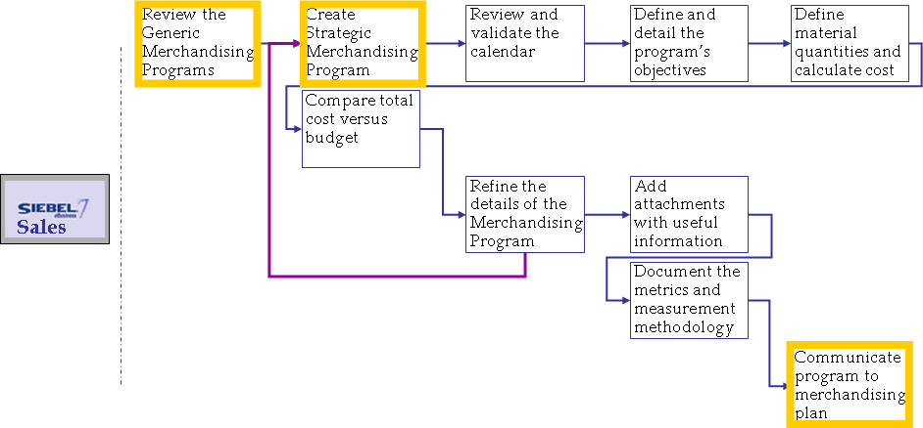
H.3 Customize Merchandising Program by account
H.3.1 Select the Merchandising options
How to review existing generic Merchandising
Programs?
1
Review Generic Merchandising Programs
Go to screen “Merchandising Program”
Select the program that you want to review
You can review Merchandising details, objectives, calendar, materials and attachments
2
3

Slide 44
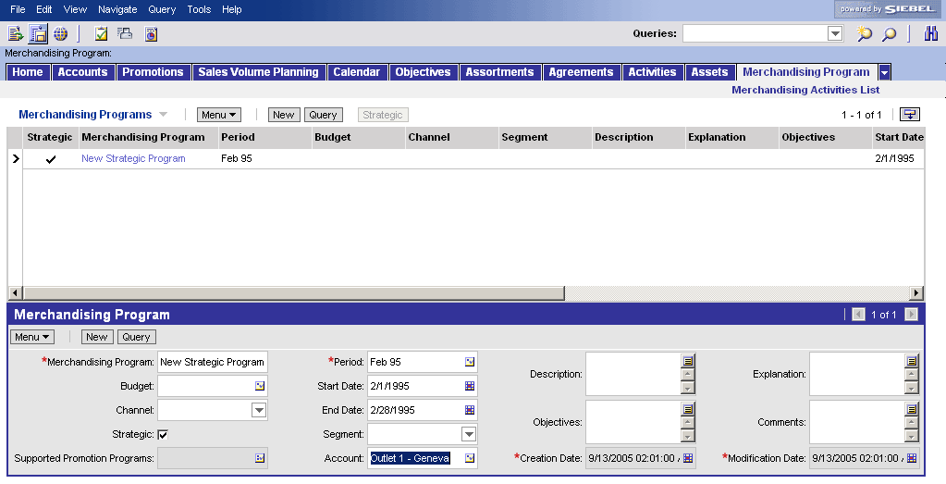
H.3 Customize Merchandising Program by account
H.3.1 Select the Merchandising options
How do you create a Strategic Merchandising
Program?
1
Create Strategic Merchandising Program
The process is identical to the process of creating a Generic Merchandising Program
Differences:
‘Strategic’ flag in Merchandising Program list applet
Only 1 Target account
1
2

Slide 45
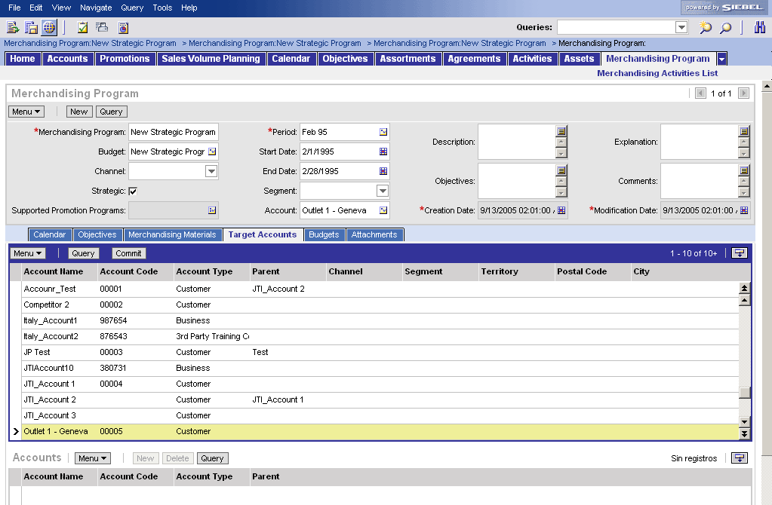
H.3 Customize Merchandising Program by account
H.3.1 Select the Merchandising options
How do you communicate a Strategic
Merchandising Plan?
Communicate program to Strategic Merchandising Plan
Go to the “Target Accounts” view
The view shows all the lists of accounts in the system
Ease your search by using the Query function
Select ONE account/outlet, i.e. the same as appears in the “Account” field
Press the “commit button” to confirm the selected strategic “Account/Outlet”
-> the application creates automatically a Merchandising Plan for the Strategic Account which can be accessed through the screens “Accounts” and “Merchandising Plans”
1
2
4
3

Slide 46
H.3 Customize merchandising program by account
Live demo in Siebel Applications
Live demo

Slide 47
Tools exercises for Merchandising Management
#4: Create Strategic Merchandising Program (1/2)
Define Strategic Merchandising Program Details
  Go to the Merchandising Program screen
  Create a generic Merchandising Program
    Strategic <flag>
    Merchandising Program: Camel Awarenes Strategic _<your initials>
    Period: 2006
    Budget: Budget Camel Awareness
    Channel: Leisure (HoReCa)
    Segment: Day Horeca
    Account: <use PickApplet> (strat. outlet/account)
Add an Objective to the Strategic Merchandising Program
  Go to the view where you can add Objectives
  Add an Objective to the Merchandising Program
  (pick an existing Objective from the pick applet)*
*the Objective was created in the Objectives screen

Slide 48
Tools exercises for Merchandising Management
#4: Create Strategic Merchandising Program (2/2)
Add a Merchandising Material to the Strategic Merchandising Program
  Go to the view where you can add Merchandising Materials
  Add a Merchandising Material to the Merchandising Program (pick an existing Merchandising Material from the pick applet)*
  Add the the following information to the Merchandising Material:
    Cost per Unit: 5€
    Amount: 50
    Total Cost: (calculated field)
Add an Attachment to the Strategic Merchandising Program
  Go to the view where you can add an attachment to the Merchandising Program
  Add an attachment to the Merchandising Program
Review budget consumption (cost/benefit analysis)
  Go to the view where the Budget Amount and the cost of the Merchandising Materials can be compared
*the Merchandising Material was created in the Product Administration screen

Slide 49
Tools exercises for Merchandising Management
#5: Create a Strategic Merchandising Plan
Communicate the Strategic Merchandising Program (make available as Merchandising Plan)
  Go to the view where you can assign the Merchandising Program to the strategic outlet/account
  Use the "Commit" button to select an account (or a selection of accounts) where the Promotion Program should be implemented
Check if the strategic Merchandising Program was made available as a strategic Merchandising Plan at a strategic Account
  Go to the Home Page and query for the strategic account for which the Strategic Merchandising Program was created
  Go to the view where you can find the Merchandising Plans related to this Strategic Account
  Drill down on the Merchandising Plan that corresponds with the Strategic Merchandising Program that was created in this exercise
  Check if the Merchandising Material is available in the Strategic Merchandising Plan*
  Check if the Attachment is available in the Strategic Merchandising Plan**
*the Merchandising Material that was added to the Merchandising Program
**the Attachment that was added to the Merchandising Program

Slide 50
H.4 Develop Merchandising materials
Tool Support
How do you develop Merchandising materials?
Better Practice process steps
  Design merchandising materials *
  Get approval on materials ¨*
  Procure merchandising materials
    Siebel Laptop can support the user by providing contact information for relevant design agencies, e.g. “Attachments” view within a Merchandising Program
Siebel
Sales
*only applicable to new Merchandising Programs

Slide 51
H.5 Ensure execution Merchandising Program
Tool support
How do you deploy Merchandising materials?
Better Practice process steps
  Communicate Merchandising instructions and guidelines¹
  Ensure deployment of Merchandising materials at PoP / PoC
  Evaluate Merchandising material consumption²
  Evaluate supply chain impact
    Siebel Sales supports this process by providing Merchandising Program details and automatic communication (“commit” function)
    Siebel Analytics supports this process by providing a dashboard page in the dashboard “Merchandising Management” (details documented in next process)
Siebel
Sales
Siebel Analytics
Siebel
Sales
Siebel Analytics
Siebel Sales support for BP process steps
Siebel Analytics support for BP process steps

Slide 52
H.5 Ensure execution Merchandising Program
Tool support
Once the Merchandising program is set up,
the execution of the supporting activities must
be ensured. The execution phase is mostly
covered by the capability “Execution at
PoP/POC”.
  The Category Developer communicates the merchandising programs to the Operational Planner so that he creates the TM Activities to support the merchandising deployment, and to control the proper execution.
Create merchandising program & guidelines
This tool process is described in the Promotion Management module
Category Developer
Create TM activity objective
Create visit activities for TM
Target and apply the activities
Schedule activities within a visit
Ref. to module
Operational
Planning
Sales
Operational
Planner
Execute Activities
Ref. to module
Execution at
POC/POP
Trade Marketers

Slide 53
H.6 Measure / evaluate efficiency & effectiveness Tool support
How do you evaluate merchandising programs
and their implementation on their efficiency and
effectiveness?
Better Practice process steps
1. Evaluate
2. Provide Feedback to procurement
Siebel Analytics
through Dashboards
Manually
Merchandising material consumption (number of materials, number of outlets, budget)
Objectives achievements
Merchandising compliance
The Merchandising concept
Supply Chain performance
The design agency performance
3. Evaluate the overall Merchandising Program
4. Document and
share lessons learned

Slide 54
H.6 Measure / evaluate efficiency & effectiveness Tool steps
Siebel Analytics allows you to perform multiple
analyses to measure the deployment of
merchandising programs. Some global dashboards
are available for ad hoc and historic analysis.
Tool steps in Siebel Applications
  First select the Merchandising Program and then analyze compliance, material consumption and budget for the selected program in the other dashboard pages
You can only select one program at a time
Select the Merchandising Program
Analyze the Merchandising material consumption
Analyze the Merchandising Plan compliance and objective achievements
Analyze the Merchandising budget
Analytics
Dashboard page
Merchandising Selection
Merchandising material consumption
Merchandising
compliance
Merchandising
budget

Slide 55
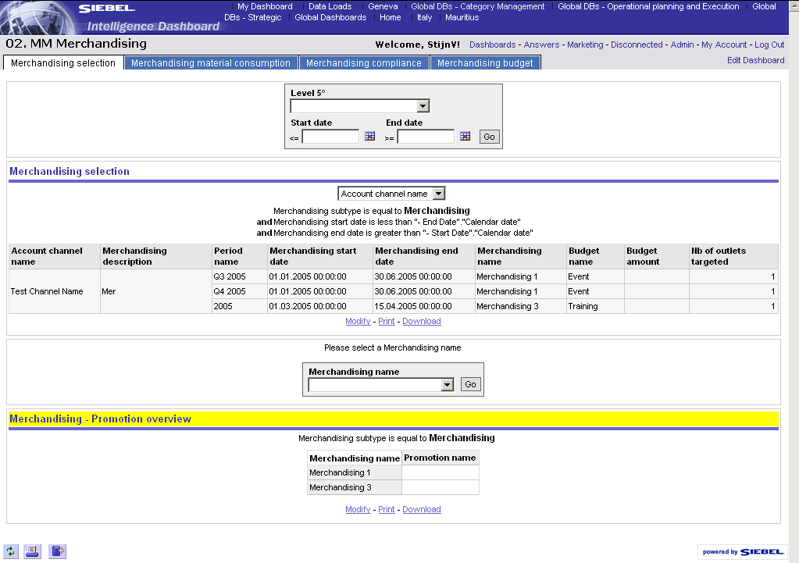
H.6 Measure / evaluate efficiency & effectiveness
Dashboard – Merchandising selection
In the first dashboard page you select the Merchandising Program that you want to analyze in the other pages
How to select the Merchandising Program for which you need to analyze consumption, compliance or budget?
Go to the “Merchandising Management” dashboard by clicking on the link “Global DBs – Category Management
Select the “Merchandising Selection” page
Narrow down the list of programs by defining the global filters
  Select a brand
  Select a time period
  Press “Go”
By changing the column selector you can analyze the programs per channel or per segment
Select the Merchandising Program that you want to analyze in the other 3 dashboard pages and press “Go”
The other pages will only show reports related to this selected program
1
2
3a
3c
3b
4
Monitoring of clusters can be done in Siebel Answers. It is not possible to filter on a cluster in the global dashboards
5

Slide 56
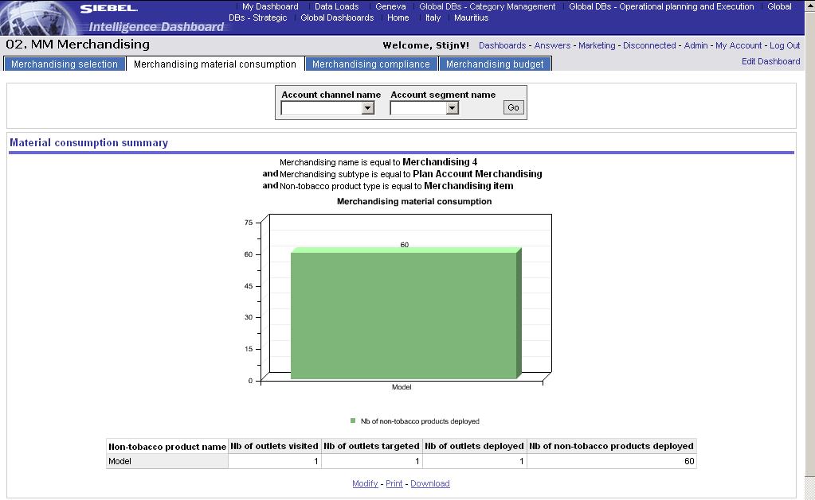
H.6 Measure / evaluate efficiency & effectiveness
Dashboard - Merchandising material consumption
How do you track and evaluate the consumption of Merchandising material by channel/segment?
This dashboard pages allows you to review the consumption-to-date of the number of Merchandising articles that have been deployed within a certain channel or segment
Select filter and press “Go”
The table below allows you to calculate the average consumption per outlet for each merchandising article
1
Siebel Analytics

Slide 57
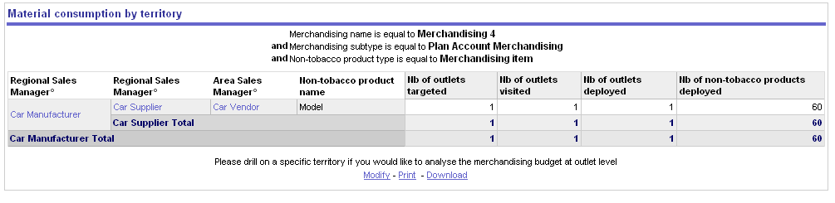
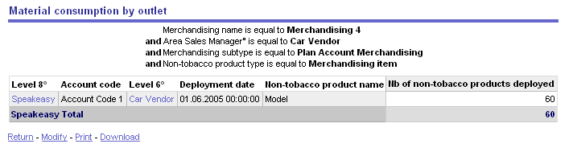
H.6 Measure / evaluate efficiency & effectiveness
Dashboard - Merchandising material consumption
How do you track and evaluate the consumption of Merchandising material by territory?
This report allows to see the consumption by geographic level. You can drill down to have a more detailed view of the territory
Drill down on Trade Marketing code
Material consumption is shown on outlet level
Siebel Analytics
1
2

Slide 58
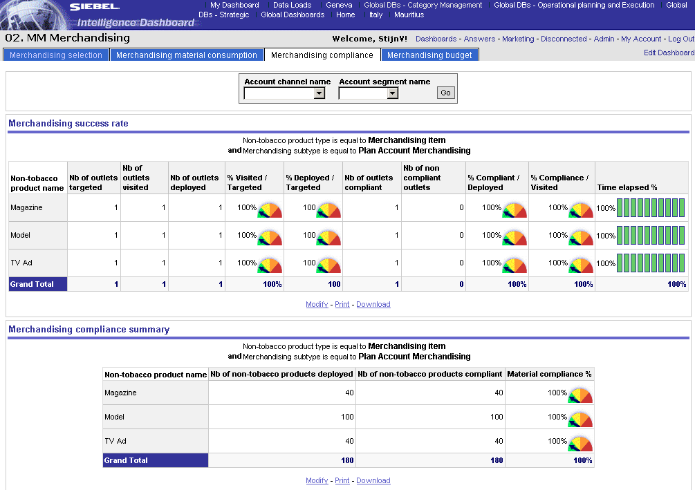
H.6 Measure / evaluate efficiency & effectiveness
Dashboard – Merchandising compliance (1/3)
How to measure & review the success of particular Merchandising ?
Go to the “Merchandising compliance” page
You can filter the Merchandising products for a specific channel/segment by selecting a specific “Account channel name” or “Account segment name”
Press “Go”
1
2
3
Siebel Analytics
The first table shows % of achieved visits and deployments and the % of compliance of deployed and visited outlets
The second table shows the compliance rate of the different merchandising materials

Slide 59
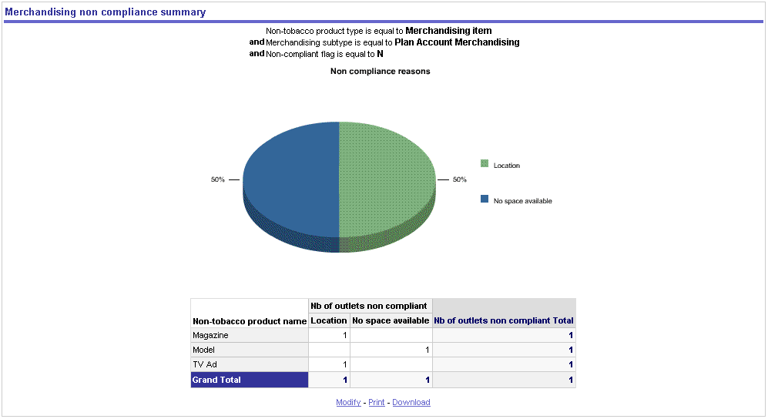
H.6 Measure / evaluate efficiency & effectiveness
Dashboard – Merchandising compliance (2/3)
Origin for non-compliance
The third report contains a graph and a table showing the amount of times a certain reason for non-compliance occurred.
Siebel Analytics

Slide 60
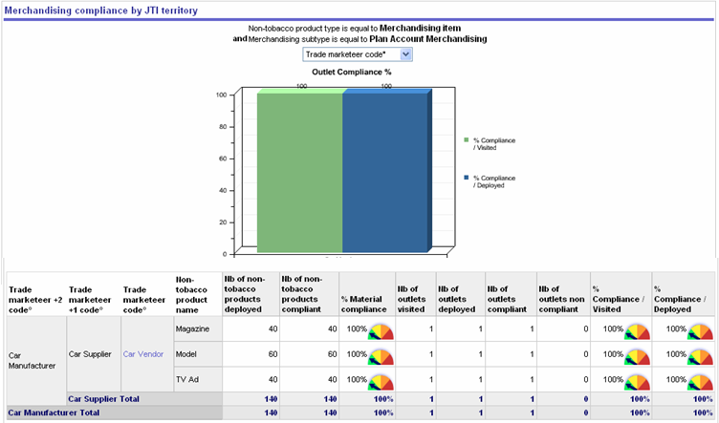
H.6 Measure / evaluate efficiency & effectiveness
Dashboard – Merchandising compliance (3/3)
Analysis of the non-compliance within the Trade Marketer organization
Click on the column selector to either see - The column selector has three values:
  Trade marketeer +2 code° (Regional)
  Trade marketeer +1 code° (Area)
  Trade marketeer code° (Territory)
  The label that will be visible depends on the log in of the user.
To analyze compliance down to outlet level, drill down on Trade Marketing code
1
Siebel Analytics
2

Slide 61
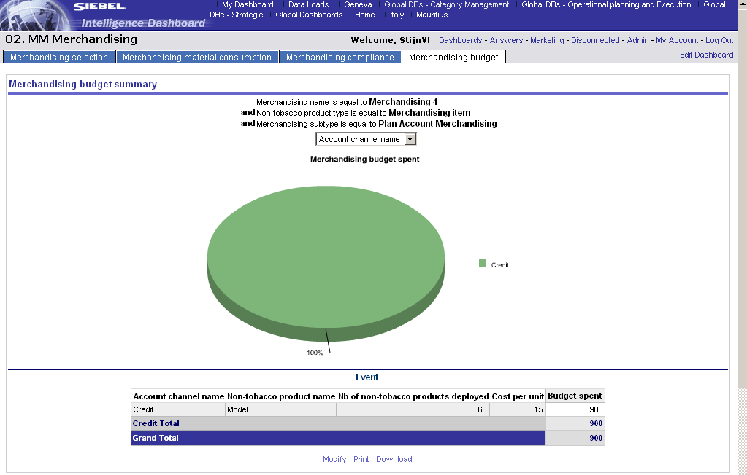
H.6 Measure / evaluate efficiency & effectiveness
Dashboard – Merchandising budget (1/2)
How can you track the already spent budget for each merchandising article, even for a specific channel?
The “Merchandising budget” page tracks the budget spent for the selected program in the page “Merchandising Selection”
Change the column selector if you want to see the budget split by channel or by segment (both for graph and table)
1
Siebel Analytics

Slide 62
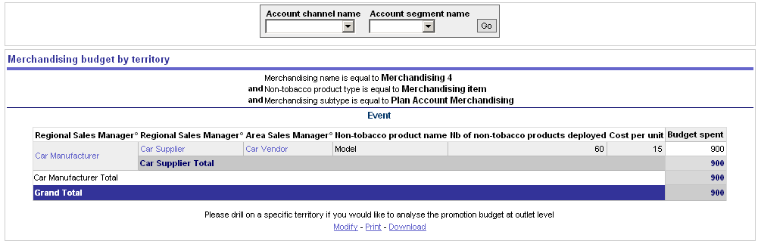
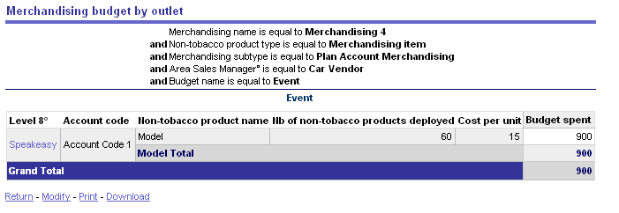
H.6 Measure / evaluate efficiency & effectiveness
Dashboard – Merchandising budget (2/2)
How can you track the already spent budget down to outlet level?
This is the bottom of the “Merchandising Budget” page
To analyze the budget spent by Merchandising Article down to outlet level, drill down on Trade Marketing code
Siebel Analytics
1
2

Slide 63
H.6 Measure / evaluate efficiency & effectiveness Live demo in Siebel Analytics
Live demo
Notes:
In sandbox environment: select on first page “Merchandising Selection” the “Merchandising 04”.
Then go to the other pages and perform drill down to outlet level from Trade Marketer level

Slide 64
Summary
Learning objectives of this module
You are now able to
  Understand how the TME applications support the BP processes for Merchandising Management
  Create Clusters in Siebel Marketing and use them in Siebel Sales CG
  Create Merchandising Programs and cascade them to multiple accounts
  Review Merchandising data in Siebel Analytics
Notes:
Review key objectives as documented on the slide with your participants.

Slide 65
Next steps after the training session
Based on what you have learned, you can
  Familiarize with the Siebel applications
  Execute the Self-Paced exercises available on the TME University Portal
  Localize training material
  Train other users in your market
  Attend more upcoming intermediate and advanced trainings to complete your knowledge of Merchandising Management

